Slide 1

Lariat
Refining your vehicle selection

Slide 2
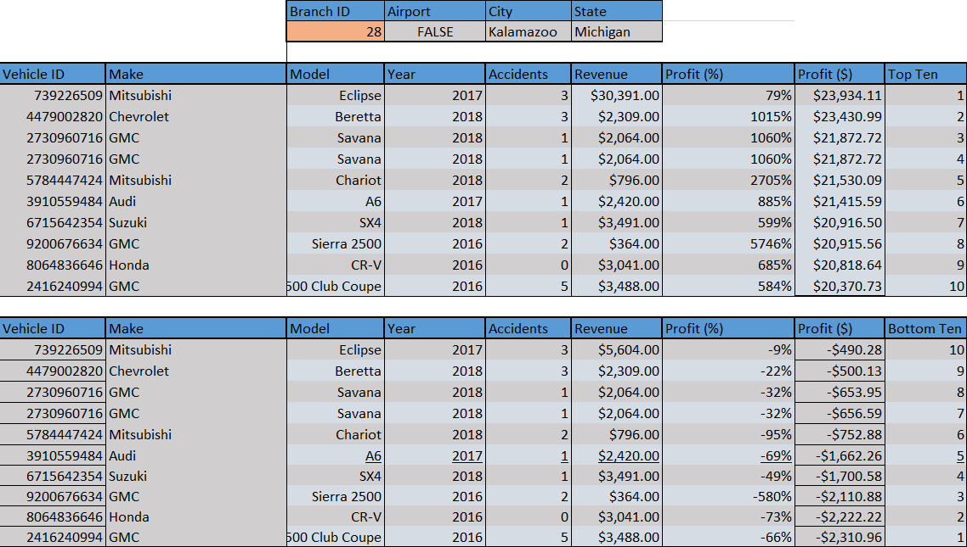

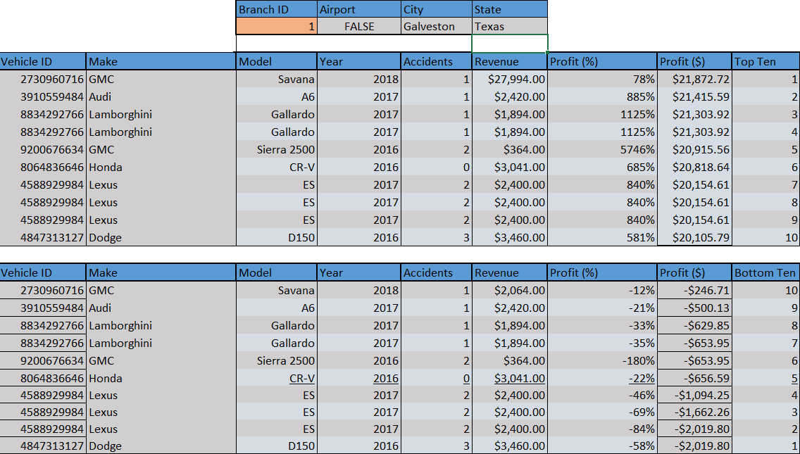
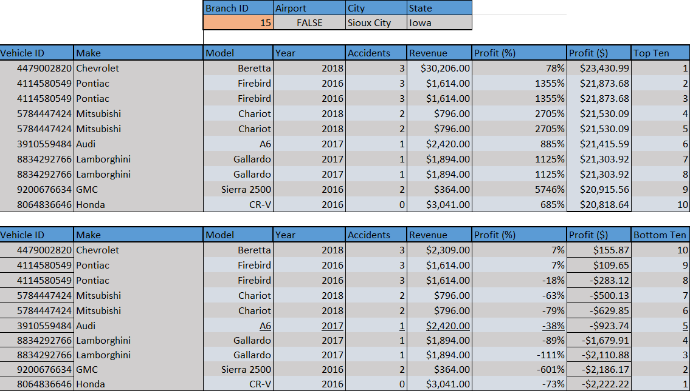
500 in, and 500 out

Slide 3
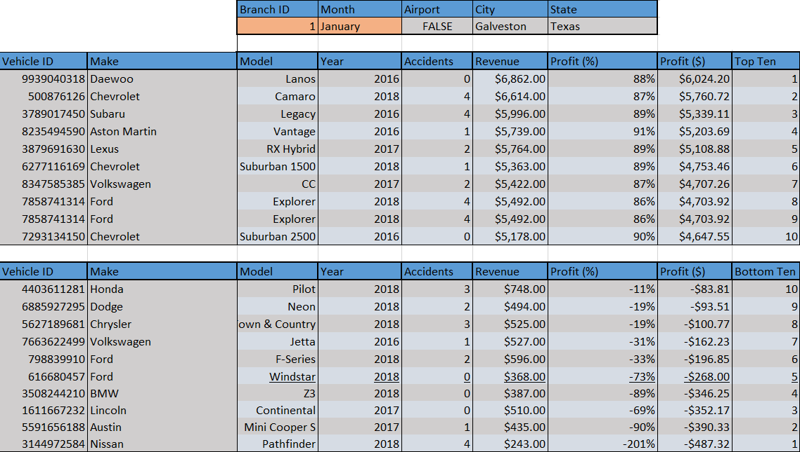
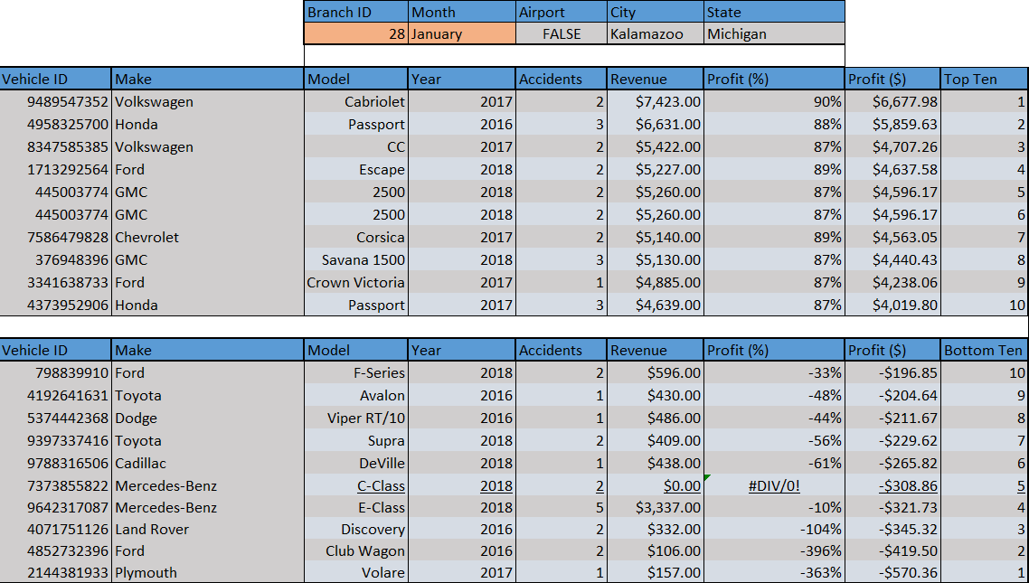
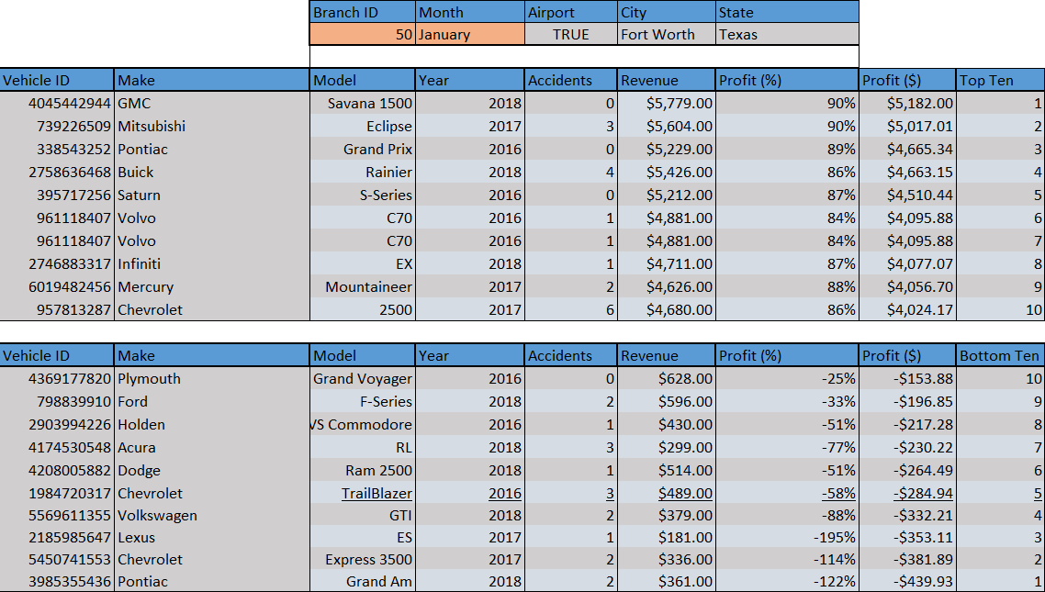
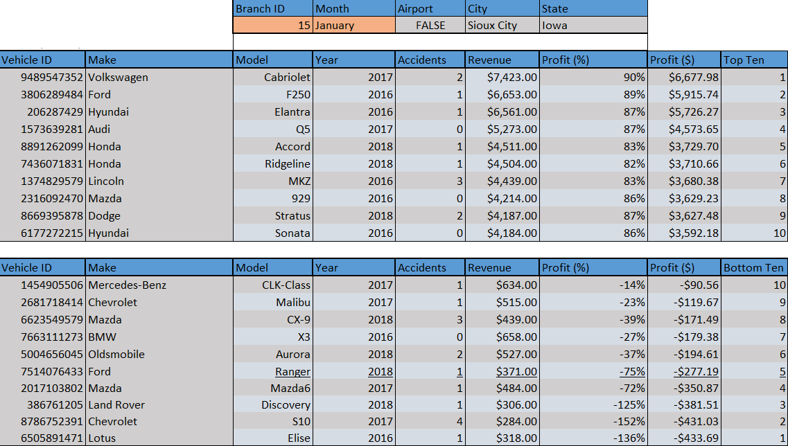
Branch to Branch changes

Slide 4
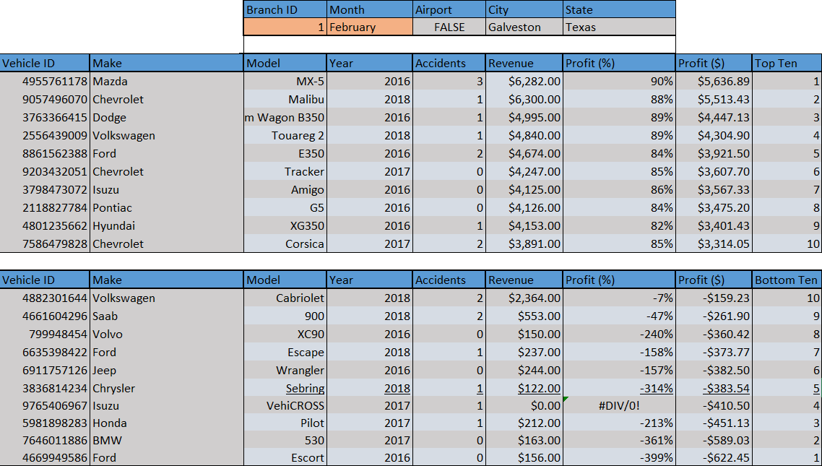
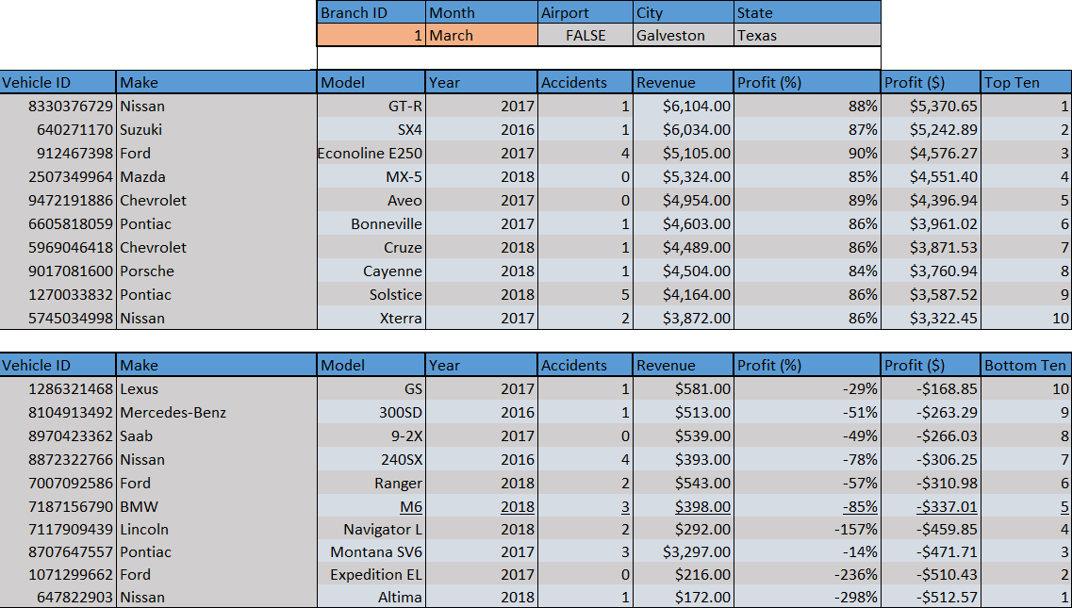
Branches and Profits

Slide 5
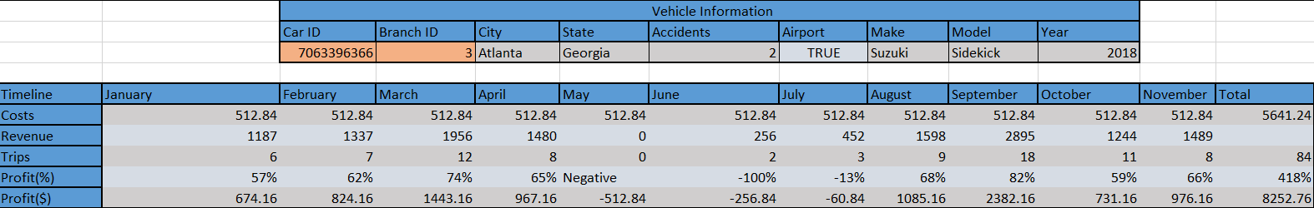
Comparing by Vehicle

Slide 6
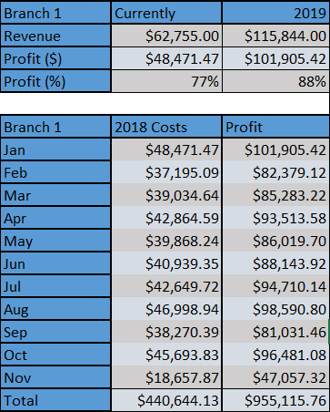
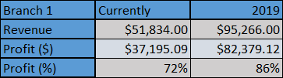
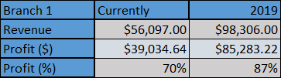
Profits
2018 vs 2019

Slide 7
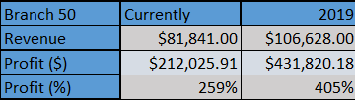
+$24M-$25M Gross Profit

Slide 8
Overall statistics of Branch 1
Branch 1 | 2018 Profit | Profit
Jan | $48,471.47 | $101,905.42
Feb | $37,195.09 | $82,379.12
Mar | $39,034.64 | $85,283.22
Apr | $42,864.59 | $93,513.58
May | $39,868.24 | $86,019.70
Jun | $40,939.35 | $88,143.92
Jul | $42,649.72 | $94,710.14
Aug | $46,998.94 | $98,590.80
Sep | $38,270.39 | $81,031.46
Oct | $45,693.83 | $96,481.08
Nov | $18,657.87 | $47,057.32
Total | $440,644.13 | $955,115.76

Slide 9
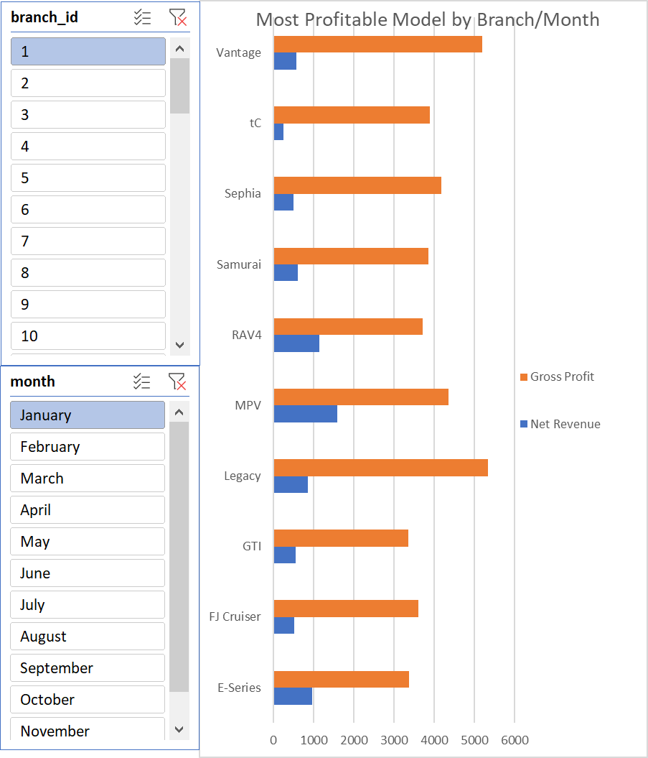
Alternative Methods Incuded

Slide 10
Thank you!
Bottom 10 Top 10

